Slide 1
Parathyroid Disorders
Prof Madunil A Niriella
Department of Medicine

Slide 2
Case history
72 year old woman
3 months history of malaise, increasing thirst and polyuria
2 years ago episode of loin pain for 1 day – uninvestigated, settled spontaneously
Recent loss of height – GP XR wedge vertebral fractures
Not on regular medication

Slide 3
Case history cont.
Examination
  Stooped posture, unremarkable
Investigations
  S Cr 105 µmol/L
  S Na 142
  S K 4.5
  S ionized Ca 2.9 mmol/L
  FBS 90 mg/dL

Slide 4
Case history cont.
Examination
  Stooped posture, unremarkable
Investigations
  S Cr 105 µmol/L
  S Na 142
  S K 4.5
  S ionized Ca 2.9 mmol/L
  FBS 90 mg/dL

Slide 5
Calcium Metabolism
Controlled by PTH & Vitamin D
Hypercalcaemia more common than hypocalcaemia
May be incidental finding

Slide 6
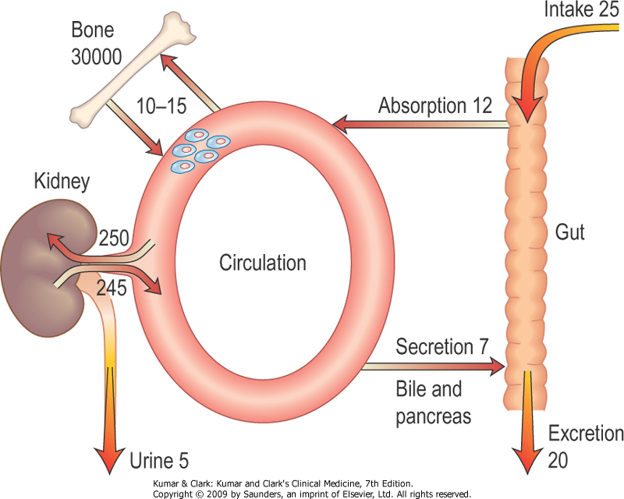
Calcium Exchange in a Normal Human

Slide 7
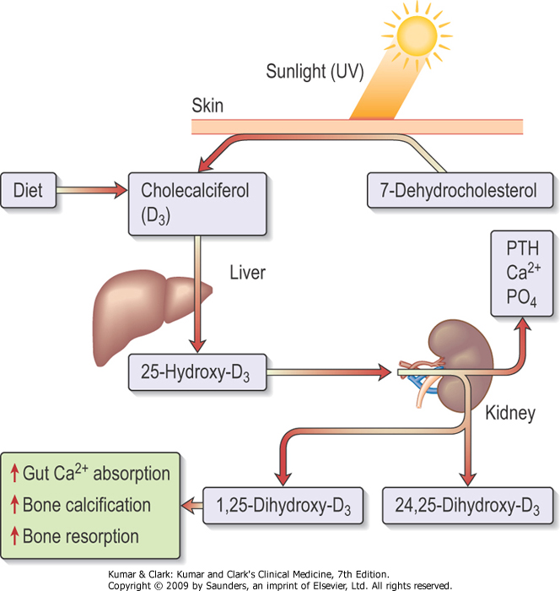
Actions of Vitamin D

Slide 8
Parathyroid Hormone (PTH)
Regulator of calcium homeostasis
Secreted by 4 parathyroid glands
Low serum calcium stimulates release

Slide 9
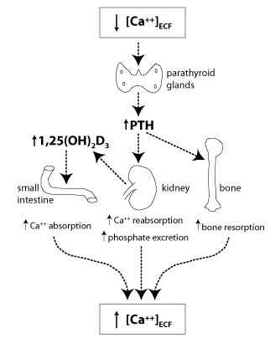
Actions of PTH

Slide 10
Hyperparathyroidism

Slide 11
May be - primary
secondary
tertiary

Slide 12
Primary Hyperparathyroidism
Common cause of hypercalcaemia
Single parathyroid adenoma (>80%)
Diffuse hyperplasia (15-20%)
Rarely – parathyroid carcinoma (<1%)
Causes ↑ S. calcium & ↓ S. phosphate
↑ 24 hour urinary calcium excretion

Slide 13
Secondary Hyperparathyroidism
Physiological compensatory hypertrophy of all parathyroid glands due to persistent hypocalcaemia
Due to – Vitamin D deficiency
Chronic kidney disease (early)
When cause of hypocalcaemia is corrected PTH becomes normal

Slide 14
Tertiary Hyperparathyroidism
Long standing secondary hyperparathyroidism → autonomous PTH secretion
eg. chronic kidney disease (advanced)
Causes ↑ s. calcium & ↑ s. phosphate

Slide 15
Causes of Hypercalcaemia
Excess PTH – primary, tertiary, ectopic
Malignancy – myeloma, bone secondaries
Excess Vitamin D – oral, granuloma, lymphoma
Excess Calcium - oral
Other endocrine disease (mild) – thyrotoxicosis, Addison’s disease
Drugs – thiazides, Vitamins A & D analogues, Lithium
Long term immobility

Slide 16
Severe hypercalcaemia (> 3 mmol/L)
malignant disease
hyperparathyroidism
advanced CKD
vitamin D toxicity

Slide 17
Clinical Features of Hypercalcaemia
Mild - usually asymptomatic
Tiredness, malaise, dehydration, depression
Renal colic (stones), polyuria, nocturia, haematuria, hypertension
Bone pain, bone cysts & ‘brown tumours’
Abdominal pain
Chondrocalcinosis & ectopic calcification
Corneal calcification

Slide 18
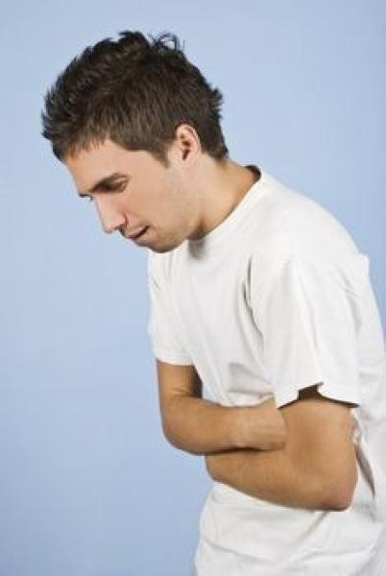
Moans, Groans, Bones, Stones!

Slide 19
Clinical Features of Hypercalcaemia ct
Symptoms from underlying cause
Malignant disease usually advanced when hypercalcaemia occurs
Common primary tumours - bronchus, breast, myeloma, oesophagus, thyroid, prostate, lymphoma, renal cell carcinoma
True 'ectopic PTH secretion' by a tumour is v.rare
(PTH-related protein)

Slide 20
Investigations - Biochemistry
Fasting serum calcium & phosphate – several
Serum PTH
Arterial blood gas - hyperchloraemic acidosis
Renal functions – usually normal
24 hour urinary calcium – hypocalciuric hypercalcaemia
↑ ALP – severe parathyroid bone disease

Slide 21
Differential Diagnosis
protein electrophoresis - myeloma
serum TSH - hyperthyroidism
0900 h cortisol and/or ACTH test - Addison's disease
serum ACE - sarcoidosis
hydrocortisone suppression test - sarcoidosis, vitamin D-mediated hypercalcaemia, some malignancies

Slide 22
Investigations - Imaging
X-ray abdomen – renal calculi nephrocalcinosis
X-ray hands – subperiosteal erosions in middle & terminal phalanges
DXA bone density scan
Parathyroid imaging - ultrasound scan
high resolution CT or MRI radio-isotope scan

Slide 23
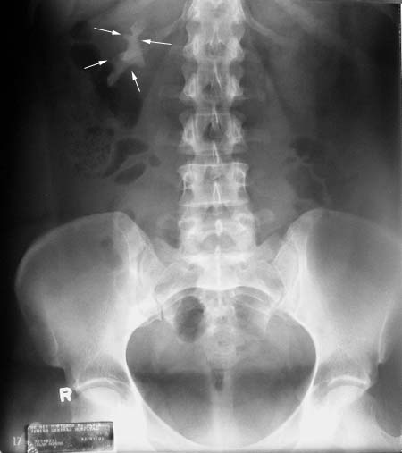
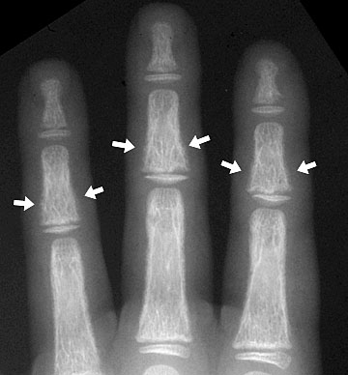
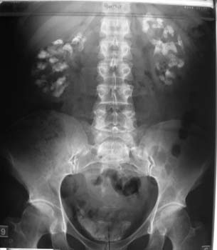

Slide 24
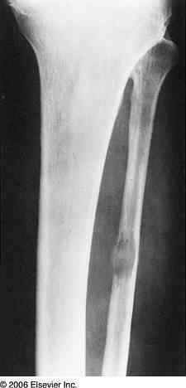
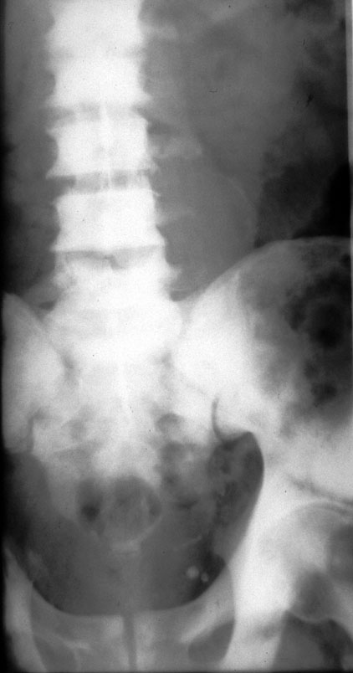
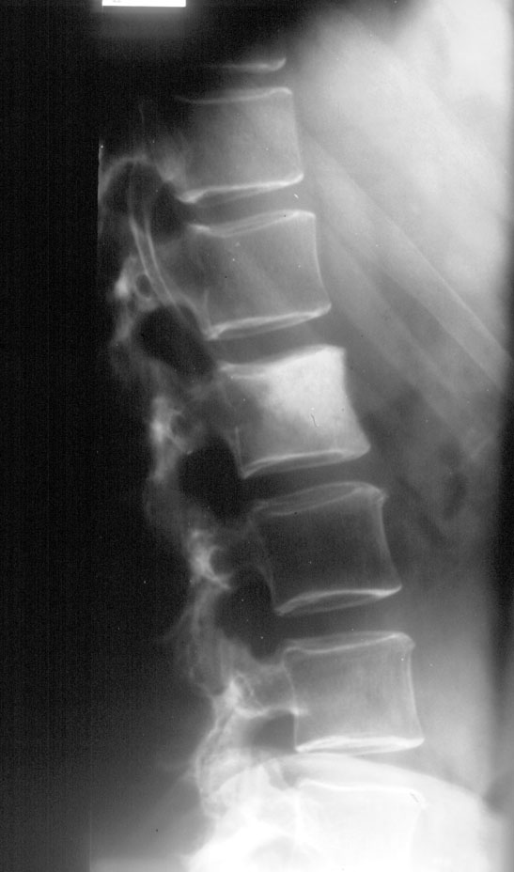
Bone Mets

Slide 25
Treatment
Emergency treatment of severe hypercalcaemia
Treatment of hyperparathyroidism

Slide 26
Treatment of Acute Severe Hypercalcaemia
Presentation – dehydration, nausea & vomiting, nocturia, polyuria, drowsiness, altered consciousness
Hydrate adequately
4-6 L N.Saline on D1, 3-4 L/day thereafter
iv Pamidronate – treatment of choice
Calcitonin - short duration of action
Prednisolone - 30-60 mg daily
Oral Phosphates - causes diarrhoea

Slide 27
Treatment of Primary Hyperparathyroidism
Medical –
high fluid intake
avoid high calcium & Vitamin D intake regular exercise
agents that target calcium-sensing receptors
(e.g. cinacalcet) - parathyroid carcinoma, dialysis

Slide 28
Treatment of Primary Hyperparathyroidism
Surgical Removal – indications are,
renal stones
impaired renal function
bone involvement
marked ↓ in cortical bone density
marked hypercalcaemia
<50 yrs of age
previous episode of acute severe hypercalcaemia

Slide 29
Treatment
Secondary hyperparathyroidism →
treat cause
Tertiary hyperparathyroidism → parathyroid resection surgery

Slide 30
Case history
72 year old woman
3 months history of malaise, increasing thirst and polyuria
2 years ago episode of loin pain for 1 day – uninvestigated, settled spontaneously
Recent loss of height – GP XR wedge vertebral fractures
Not on regular medication

Slide 31
Case history cont.
Examination
  Stooped posture, unremarkable
Investigations
  S Cr 105 µmol/L
  S Na 142
  S K 4.5
  S ionized Ca 2.9 mmol/L
  FBS 90 mg/dL

Slide 32
Case history cont.
What investigation would be helpful for further evaluation?

Slide 33
Case history cont.
S PTH – 12.6 pmol/L
24 hour Urinary Ca excretion – 9.8 mmol
What is the diagnosis?
What is the condition which ‘mimics’?
How to differentiate?

Slide 34
Hypoparathyroidism

Slide 35
Causes
  Destruction / damage of parathyroid glands
    post thyroidectomy or post parathyroidectomy
    autoimmune
    radiation
  Failure of parathyroid development
  Failure of PTH secretion
    severe hypomagnesaemia
  Failure of PTH action

Slide 36
Types
Primary (Idiopathic) Hypoparathyroidism
Pseudo Hypoparathyroidism
Pseudo-pseudo Hypoparathyroidism

Slide 37
Primary Hypoparathyroidism
↓ S.calcium with ↑ S.phosphate
Associated with other autoimmune disorders in Polyglandular Autoimmune Syndrome –
vitiligo, cutaneous candidiasis

Slide 38
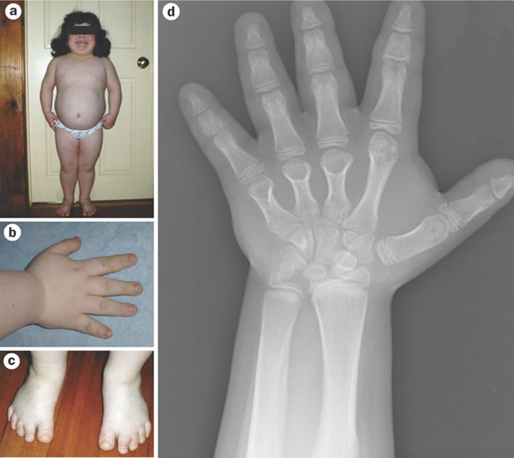
Pseudo Hypoparathyroidism
End organ resistance to
PTH
Short stature
Short metacarpals
Subcutaneous
calcification
Intellectual impairment

Slide 39
Pseudo-pseudo Hypoparathyroidism
Phenotype similar to those with pseudo hypoparathyroidism
But calcium metabolism is normal

Slide 40
Other Causes of Hypocalcaemia
Increased phosphate levels –
Chronic kidney disease (common)
Phosphate therapy
Vitamin D deficiency –
Osteomalacia / rickets, Vitamin D resistance
Drugs – Calcitonin, Bisphosphonates
Misc - Acute pancreatitis (common)
Citrated blood in massive transfusion (common)
Low plasma albumin (malnutrition, CLCD) Malabsorption (coeliac disease)

Slide 41
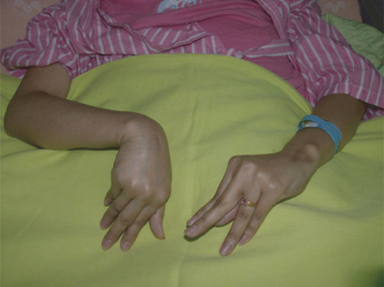
Symptoms of Hypocalcaemia
  Paraesthesiae of hands and feet
  Circumoral numbness
  Cramps, anxiety & tetany
  Convulsions
  Laryngeal stridor
  Dystonia
  Psychosis

Slide 42
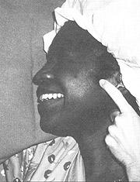
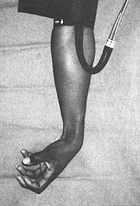
Signs of Hypocalcaemia
    Chvostek’s sign
    Trousseau’s sign
    Papilloedema
    Cataracts
    (prolonged QT on ECG)

Slide 43
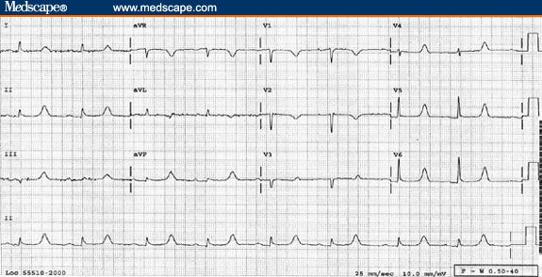
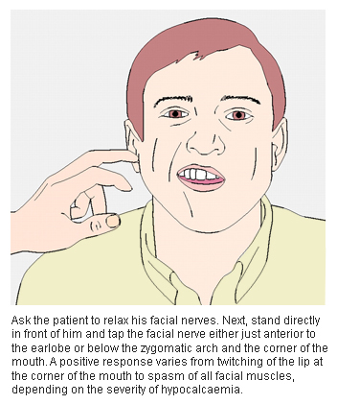
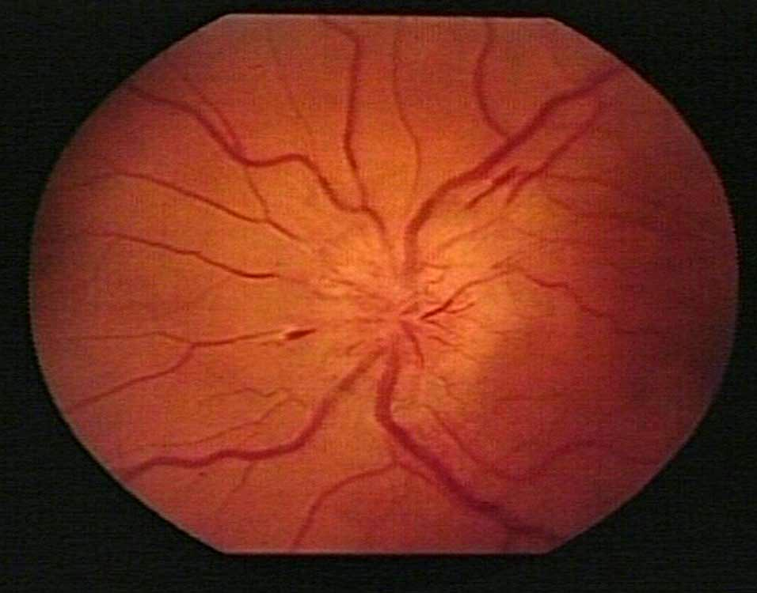

Slide 44
Investigations in Hypocalcaemia
    Serum calcium & phosphate
    PTH – absent/low in hypoparathyroidism
    high in other causes of hypocalcaemia
    S.creatinine
    Parathyroid antibodies
    Serum 25-hydroxy Vitamin D – low in vitamin D deficiency
    S.magnesium
    X ray of hands – short 4th metacarpals in pseudo hypoparathyroidism

Slide 45
Management of Hypoparathyroidism
    Alpha-hydroxylated derivatives of Vitamin D
    – eg alfa calcidol
    Regular monitoring of S. calcium

